Slide 1
DDM
Steven Miletić | 11/11/2024

Slide 2
Overview
A brief recap
Classical experiments
Threshold manipulations
Starting point manipulations
Rate manipulations
Practical issues when fitting
Likelihoods
Identifiability
Scaling

Slide 3
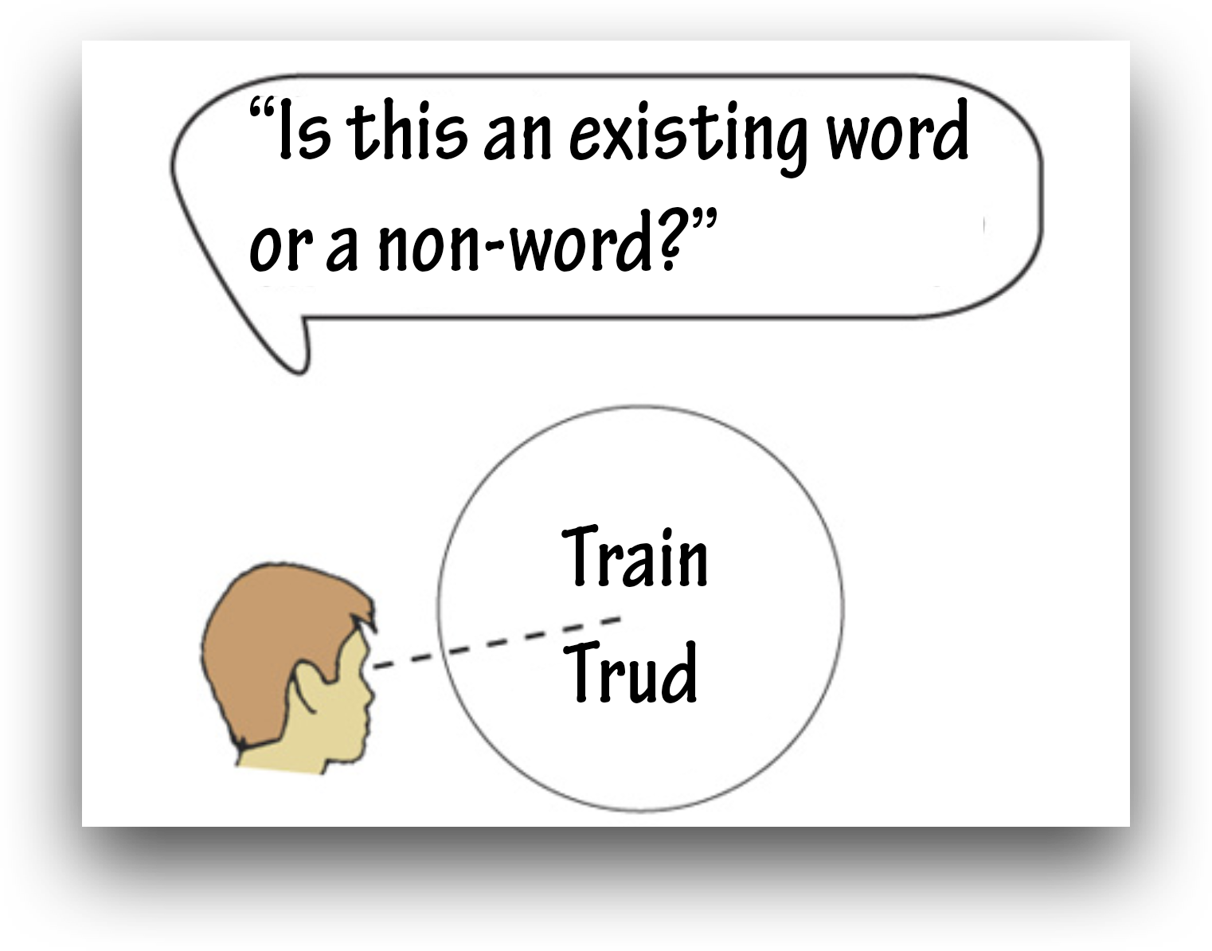
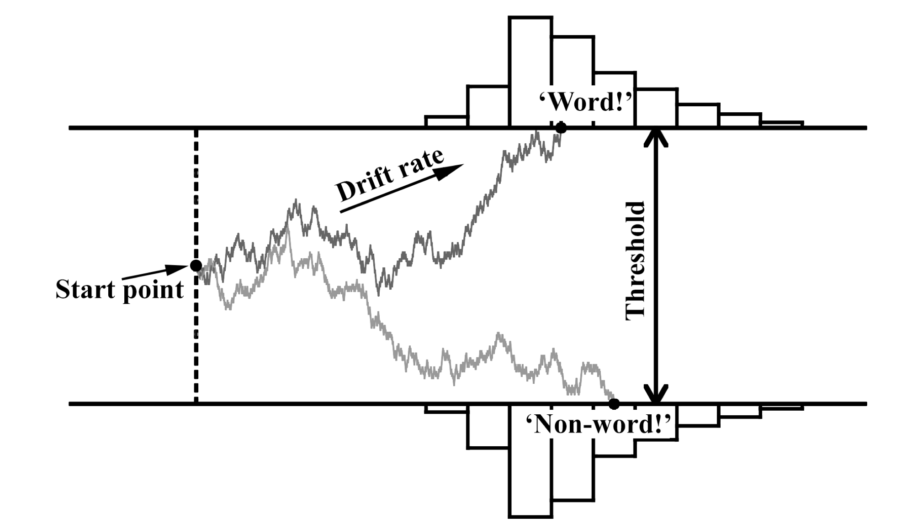
The DDM: A brief recap
Choices are made through accumulation of noisy samples until threshold

Slide 4
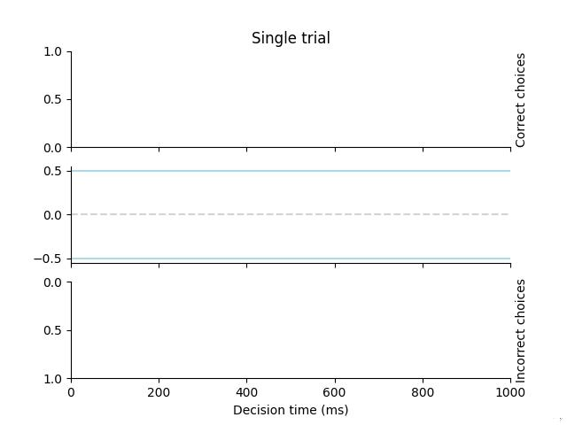
The DDM: A brief recap
Choices are made through accumulation of noisy samples until threshold

Slide 5
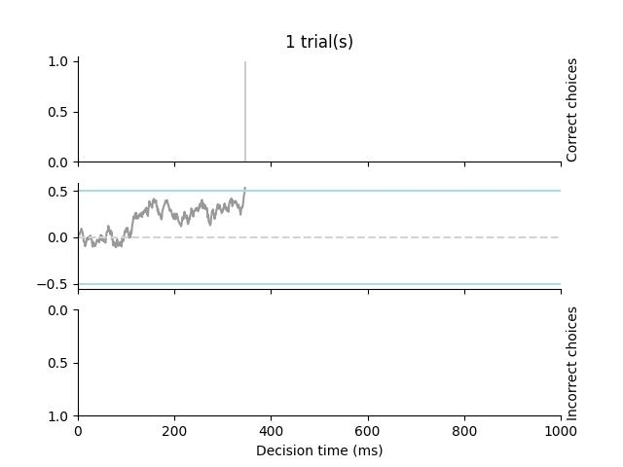
The DDM: A brief recap
Choices are made through accumulation of noisy samples until threshold
Response time distributions arise as a result of sampling noise

Slide 6
The DDM: A brief recap
Choices are made through accumulation of noisy samples until threshold
Response time distributions arise as a result of sampling noise

Slide 7
The DDM: A brief recap
Parameters:
Drift rate: Mean speed of accumulation (‘signal-to-noise’)
Threshold: How much evidence is required?
Starting point: Is there an a priori belief towards one option?
Non-decision time: Time for perceptual and motor processes
(aka the Wiener diffusion model)

Slide 8
The DDM: A brief recap
‘Secondary’ parameters:
Drift rate variability across trials
Starting point variability across trials
Non-decision time variability across trials
(aka the ‘full’ DDM)

Slide 9
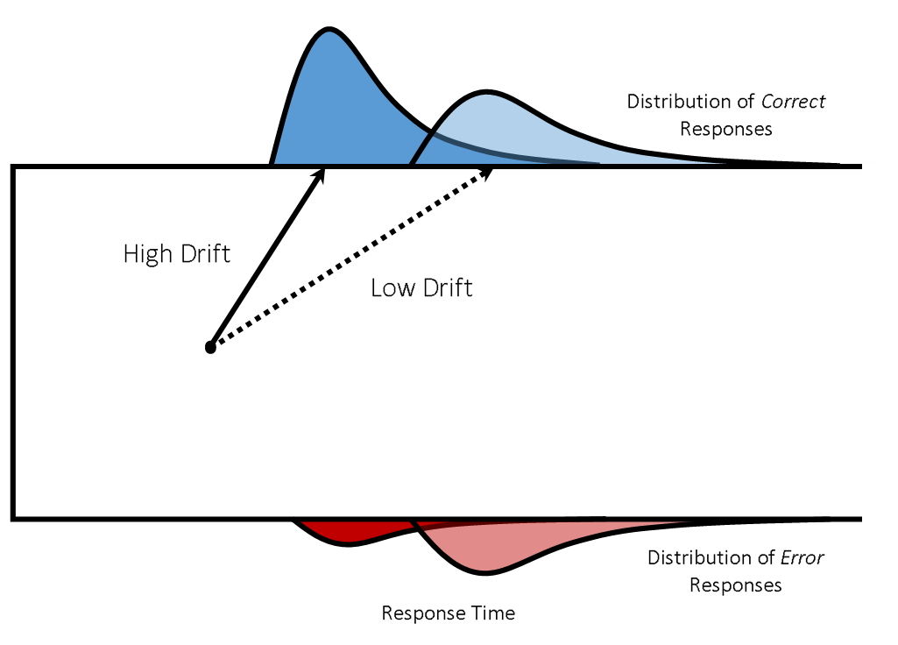
The DDM: A brief recap
Each parameter uniquely affects RT distributions
1. Lower drift rate:
- Slower RTs, long tail
- Less accurate

Slide 10
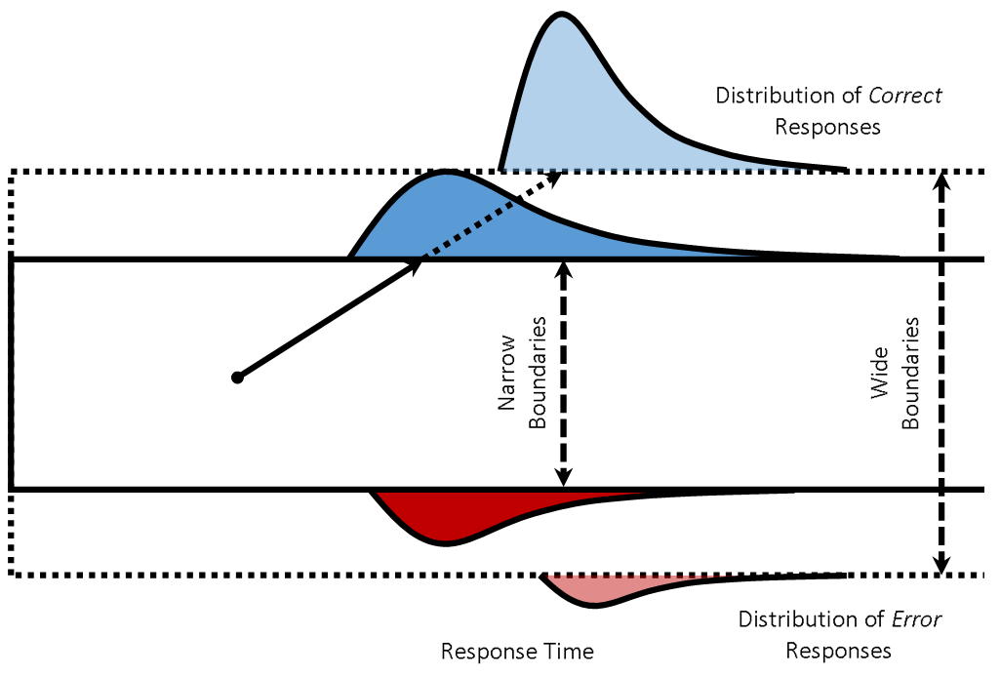
The DDM: A brief recap
Each parameter uniquely affects RT distributions
2. Lower threshold:
- Faster
- Less accurate

Slide 11
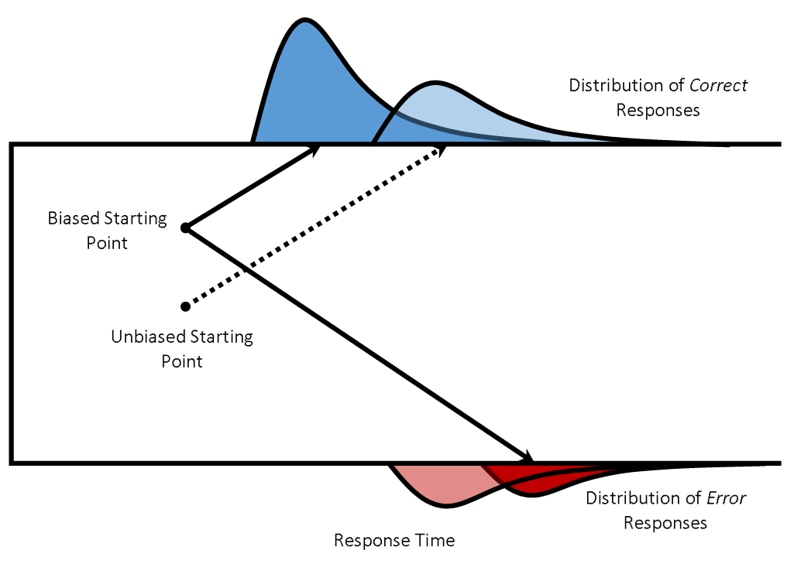
The DDM: A brief recap
Each parameter uniquely affects RT distributions
3. Biased start point:
- Faster RTs for biased choice
- Slower RTs for other choice
- More lower choices

Slide 12
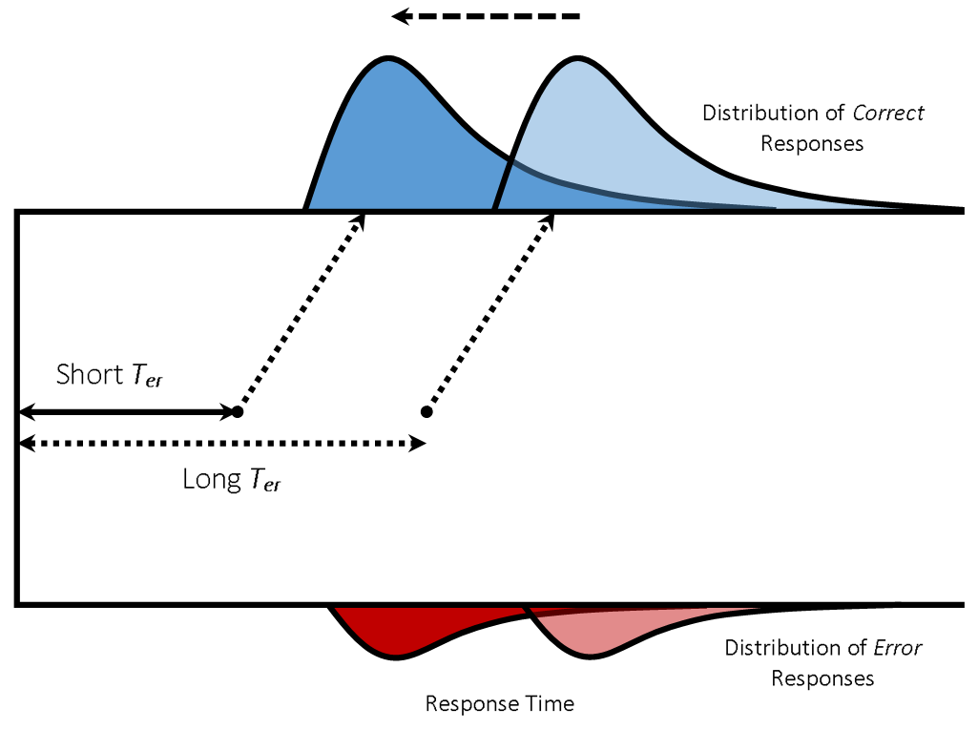
The DDM: A brief recap
Each parameter uniquely affects RT distributions
4. Lower non-decision time:
- Faster RTs
- Shape unaffected
- Accuracy unaffected

Slide 13
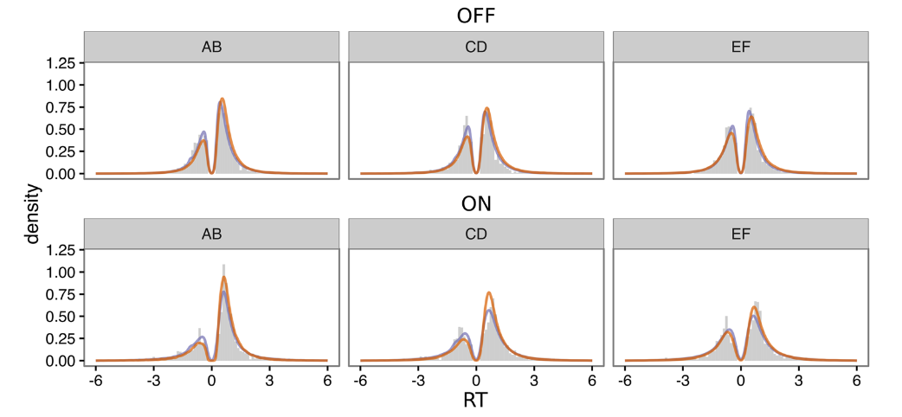
Visualizing RT distributions
Histograms are easy to understand, but often hard to see quality of fit

Slide 14
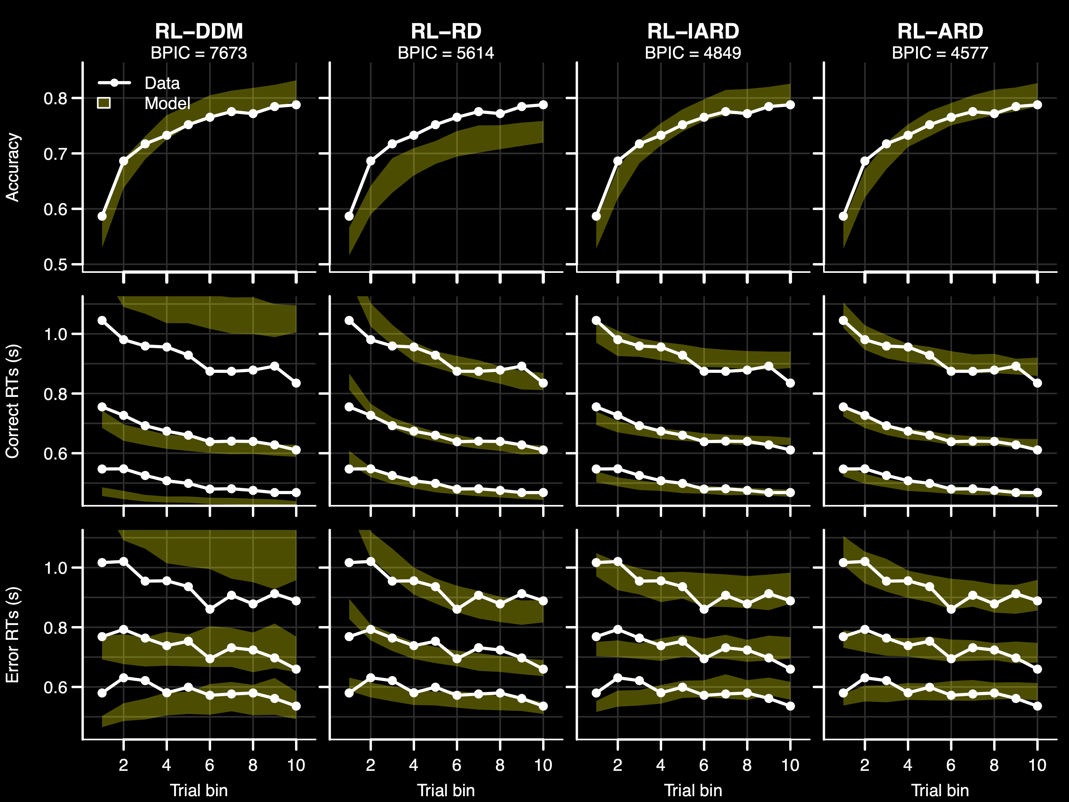
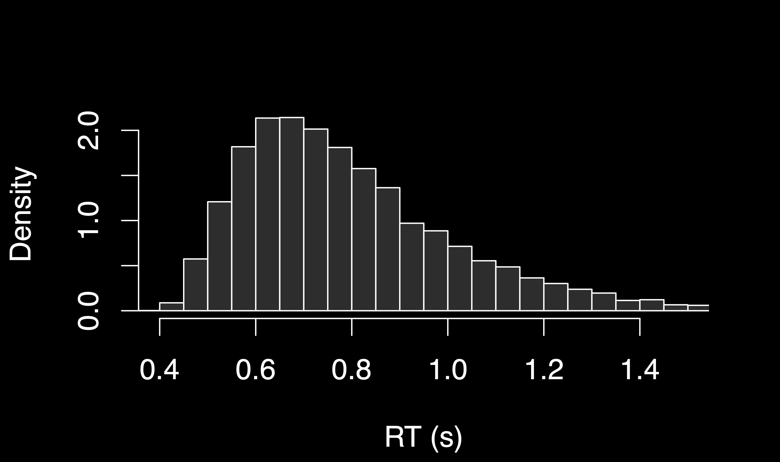
Visualizing RT distributions
Quantile plots summarize RT distributions in 3-5 quantiles

Slide 15
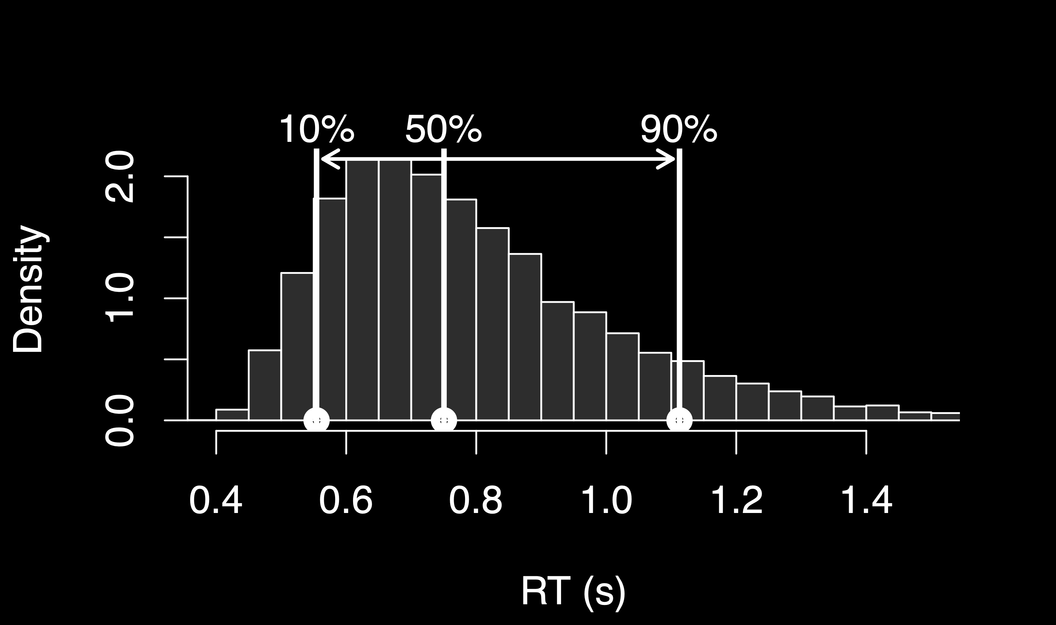
Visualizing RT distributions
Quantile plots summarize RT distributions in 3-5 quantiles

Slide 16

Visualizing RT distributions
Quantile plots summarize RT distributions in 3-5 quantiles

Slide 17
Visualizing RT distributions
Quantile plots summarize RT distributions in 3-5 quantiles

Slide 18
Overview
A brief recap
Classical experiments
Threshold manipulations
Starting point manipulations
Rate manipulations
Practical issues when fitting
Likelihoods
Identifiability
Scaling

Slide 19
Wagenmakers et al. (2008)
Lexical decision task
Is ‘XXXX’ an existing word?
https://www.psytoolkit.org/experiment-library/experiment_ldt.html

Slide 20
Wagenmakers et al. (2008)
Lexical decision task
Is ‘XXXX’ an existing word?
15/19 participants, 1920 trials(!) each
Four difficulties:
High frequency words (323 p/M)
Low frequency words (4.41 p/M)
Very low frequency words (0.38 p/M)
Non-words

Slide 21
Wagenmakers et al. (2008)
Lexical decision task
Is ‘XXXX’ an existing word?
Experiment 1: Speed-accuracy trade-off instructions
“Try to respond fast”
Or
“Try to respond accurately”

Slide 22
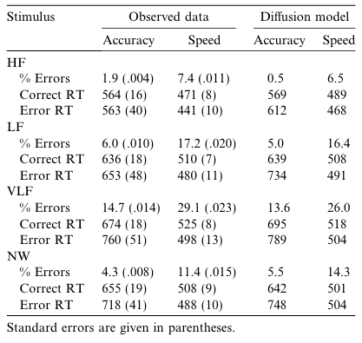
Wagenmakers et al. (2008)
Lexical decision task
Is ‘XXXX’ an existing word?
Experiment 1: Speed-accuracy trade-off instructions
“Try to respond fast”
Or
“Try to respond accurately”

Slide 23
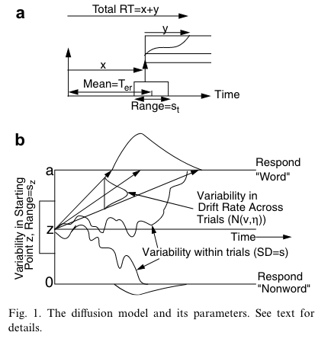
Wagenmakers et al. (2008)
Lexical decision task
Is ‘XXXX’ an existing word?
Experiment 1: Speed-accuracy trade-off instructions
“Try to respond fast”
Or
“Try to respond accurately”

Slide 24
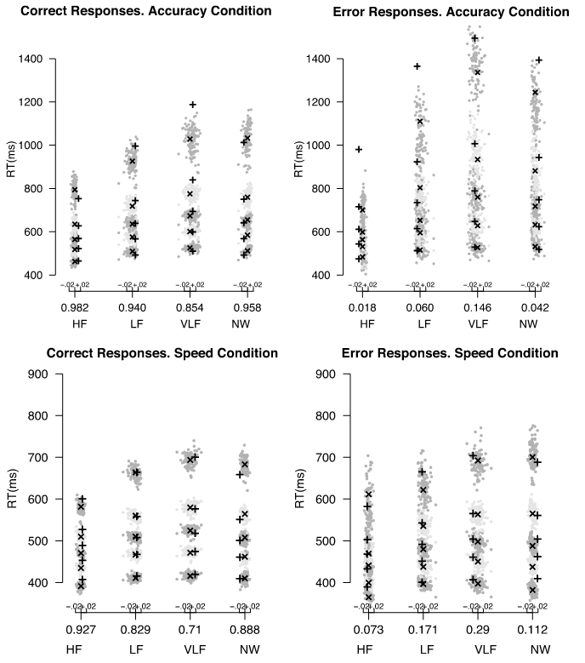
Wagenmakers et al. (2008)
Lexical decision task
Is ‘XXXX’ an existing word?
Experiment 1: Speed-accuracy trade-off instructions
“Try to respond fast”
Or
“Try to respond accurately”
Notes:
Crosses are data, plusses are model

Slide 25
Wagenmakers et al. (2008)
Lexical decision task
Is ‘XXXX’ an existing word?
Experiment 1: Speed-accuracy trade-off instructions
“Try to respond fast”
Or
“Try to respond accurately”
Notes:
Crosses are data, plusses are model

Slide 26
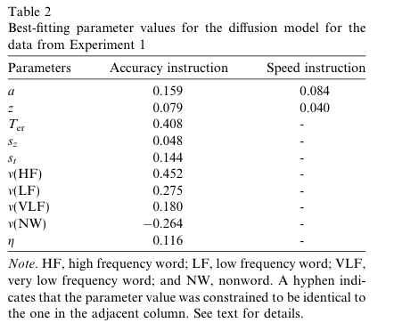
Wagenmakers et al. (2008)
Lexical decision task
Is ‘XXXX’ an existing word?
Experiment 1: Speed-accuracy trade-off instructions
“Try to respond fast”
Or
“Try to respond accurately”
Notes:
Crosses are data, plusses are model

Slide 27
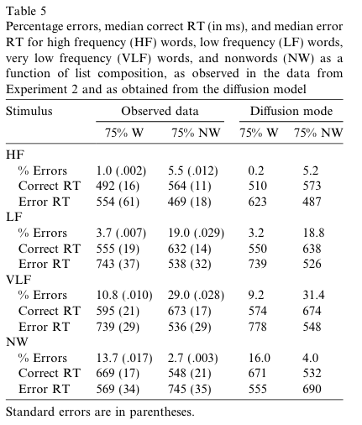
Wagenmakers et al. (2008)
Lexical decision task
Is ‘XXXX’ an existing word?
Experiment 2: Base rates
Every block of 92 trials, 75% of stimuli were word or nonword stimuli
Notes:
Crosses are data, plusses are model

Slide 28
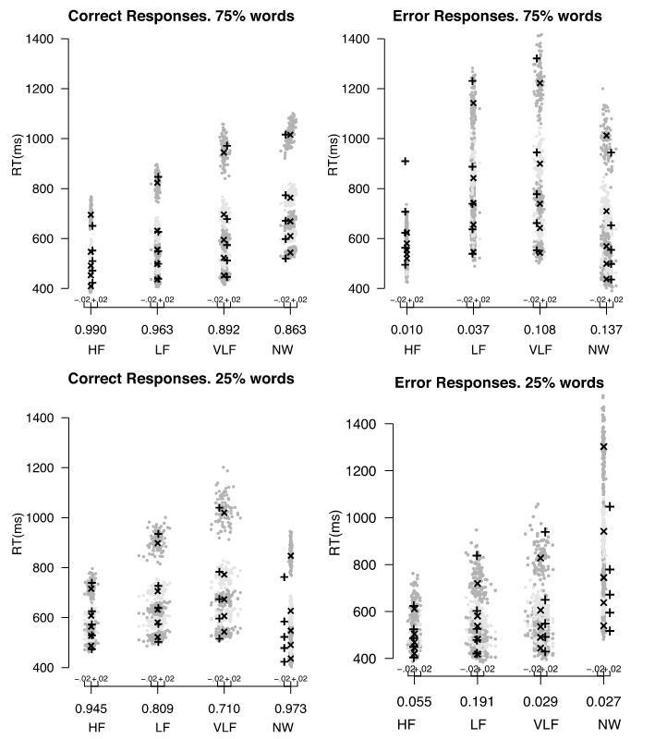
Wagenmakers et al. (2008)
Lexical decision task
Is ‘XXXX’ an existing word?
Experiment 2: Base rates
Every block of 92 trials, 75% of stimuli were word or nonword stimuli
Notes:
Crosses are data, plusses are model

Slide 29
Wagenmakers et al. (2008)
Lexical decision task
Is ‘XXXX’ an existing word?
Experiment 2: Base rates
Every block of 92 trials, 75% of stimuli were word or nonword stimuli
Notes:
Crosses are data, plusses are model

Slide 30
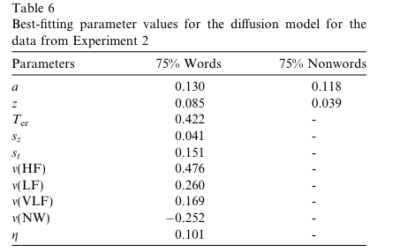
Wagenmakers et al. (2008)
Lexical decision task
Is ‘XXXX’ an existing word?
Experiment 2: Base rates
Every block of 92 trials, 75% of stimuli were word or nonword stimuli
Notes:
Crosses are data, plusses are model

Slide 31
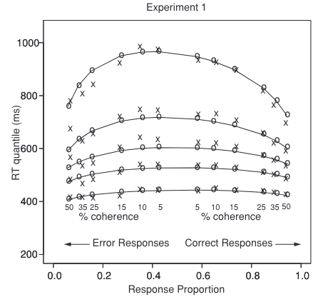
Other experiments
Ratcliff & McKoon (2008)
Three different experiments, aimed at:
Effect of difficulty (experiment 1)
Effect of SAT instructions (experiment 2)
Effect of base rates (experiment 3)

Slide 32
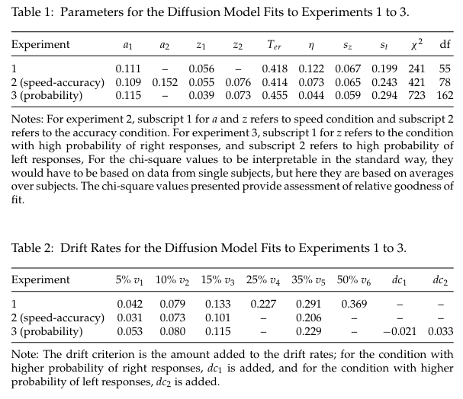
Other experiments
Ratcliff & McKoon (2008)
Three different experiments, aimed at:
Effect of difficulty (experiment 1)
Effect of SAT instructions (experiment 2)
Effect of base rates (experiment 3)

Slide 33
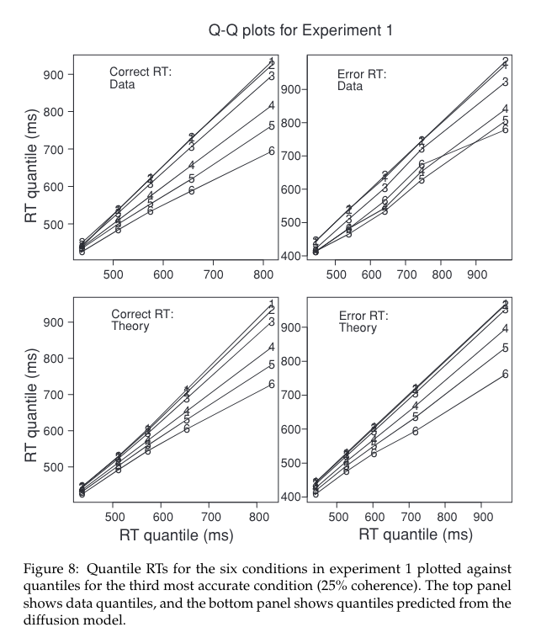
Other experiments
Ratcliff & McKoon (2008)
Three different experiments, aimed at:
Effect of difficulty (experiment 1)
Effect of SAT instructions (experiment 2)
Effect of base rates (experiment 3)
See also Voss et al. (2004)
Response hand handicap
Reward bias

Slide 34
Other experiments
How does choice behavior change with age?
Ratcliff et al. (2006): People get slower, but why?
4 tasks: Signal detection, Letter discrimination, Brightness discrimination, Recognition memory
Speed-accuracy trade-off manipulation
3 groups of participants: college students, 60-74 years olds, and 75-85 years old

Slide 35
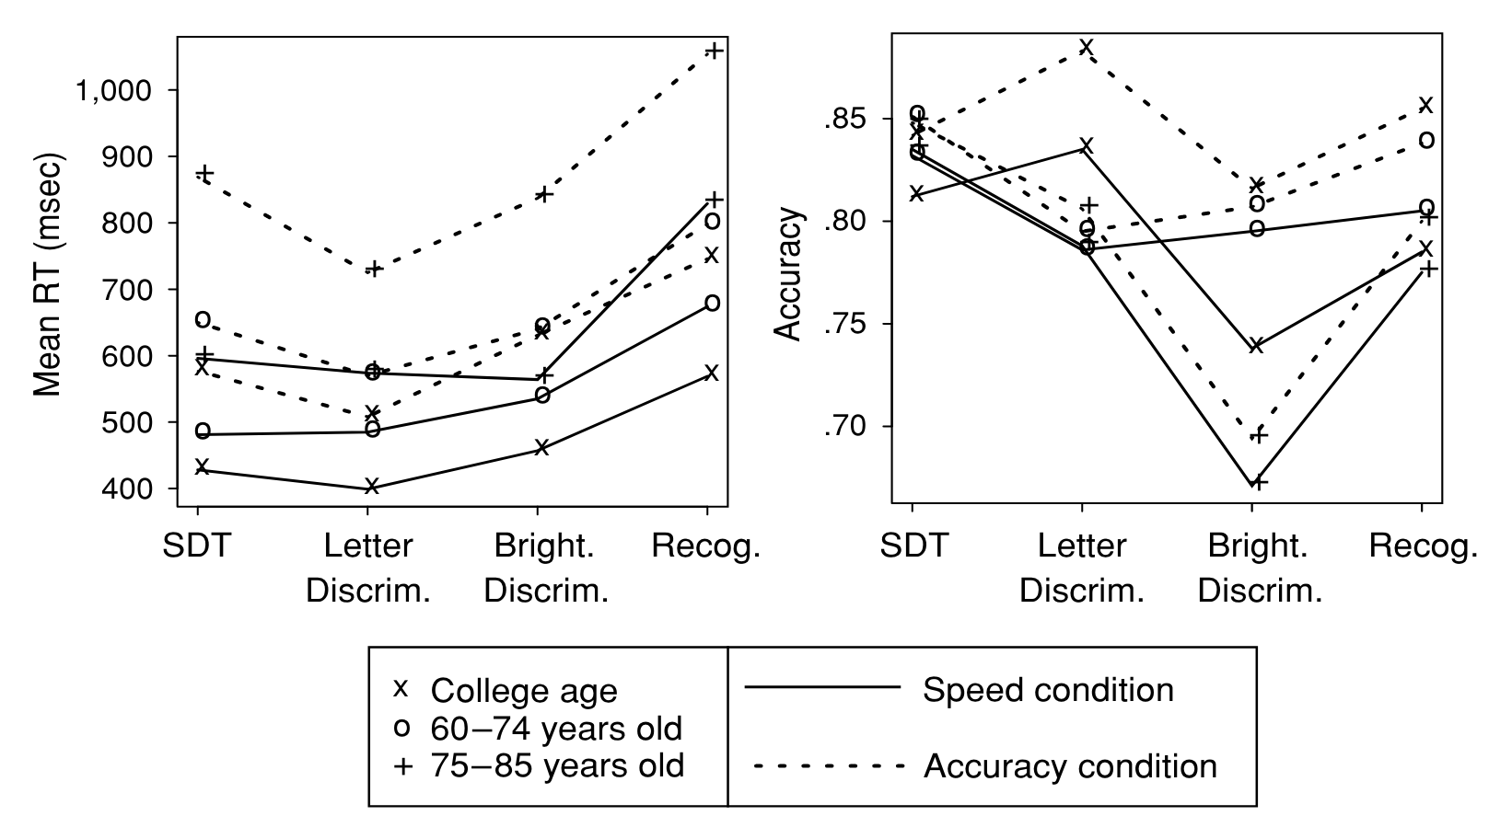
Other experiments
How does choice behavior change with age?
Ratcliff et al. (2006): People get slower, but why?
4 tasks: Signal detection, Letter discrimination, Brightness discrimination, Recognition memory
3 groups of participants: college students, 60-74 years olds, and 75-85 years old

Slide 36
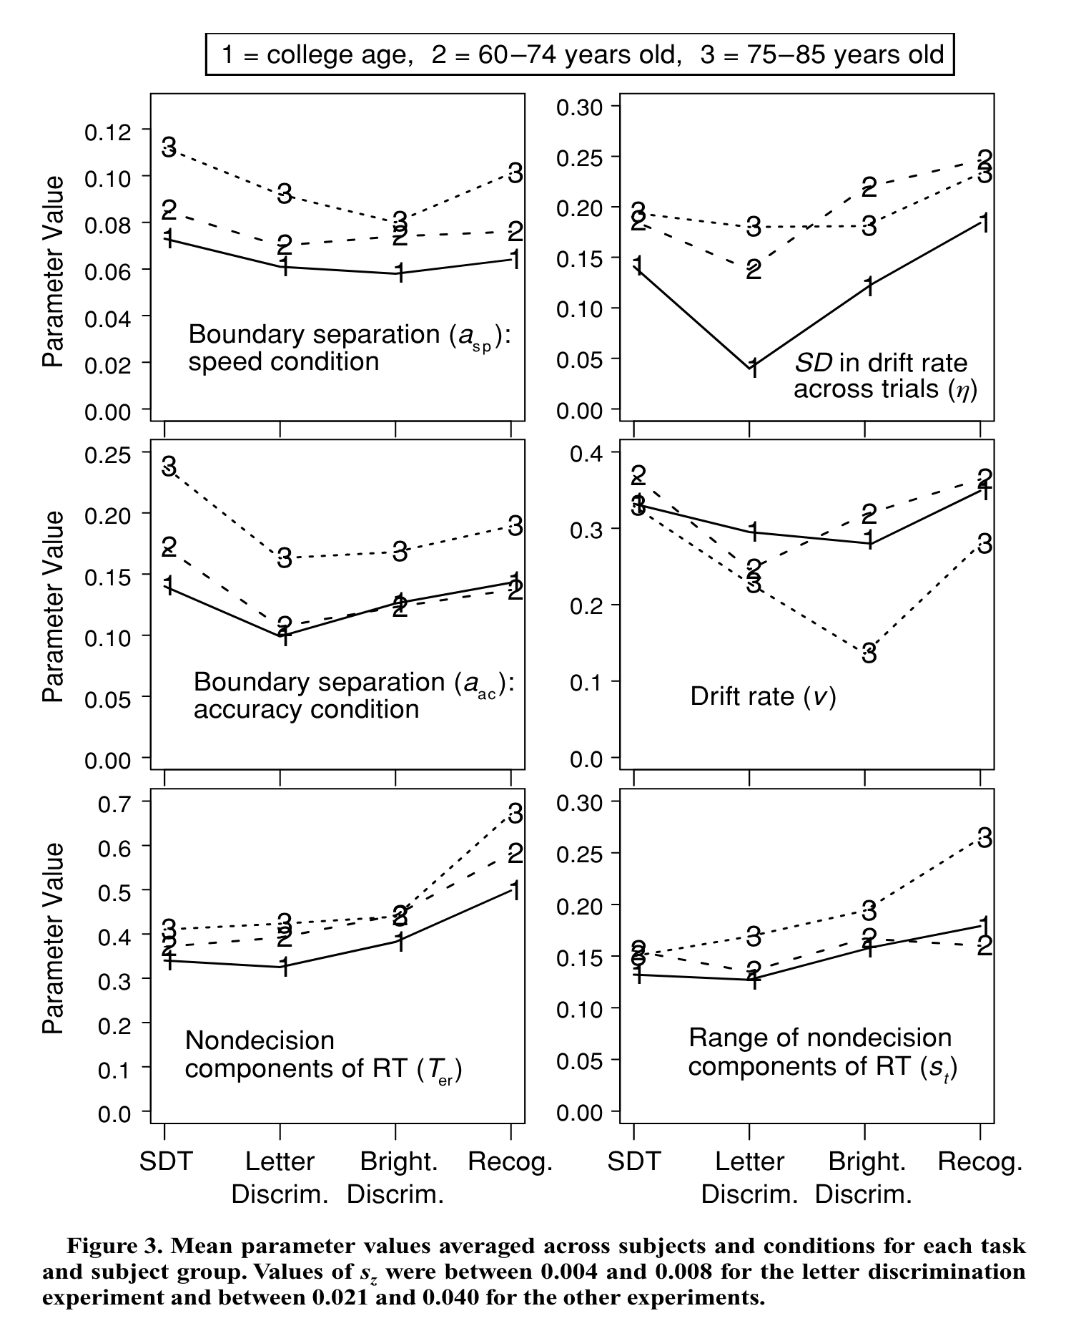
Other experiments
How does choice behavior change with age?
DDM parameter changes

Slide 37
Other experiments
How does choice behavior change with age?
DDM parameter changes
Contrary to most intuitions, older people process information roughly equally fast as young people.
They’re slower because they’re more cautious and have higher non-decision times

Slide 38
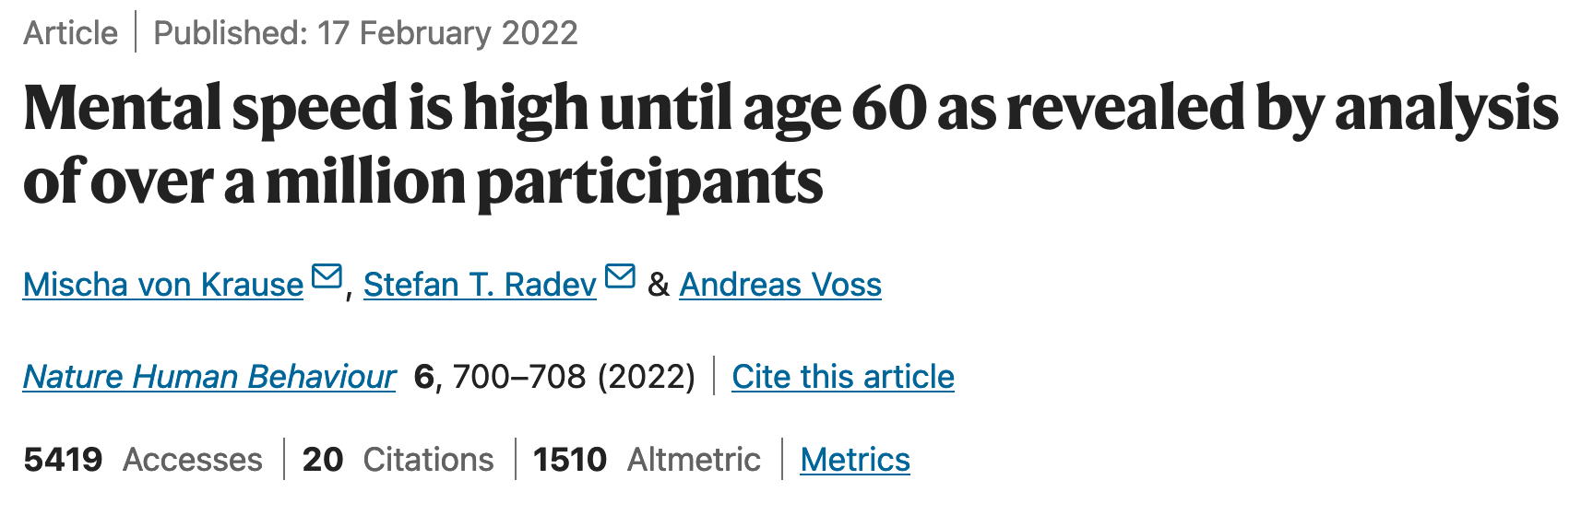
Other experiments
Really? Is this not some weird artefact of the data?
Notes:
1.2 MILLION participants

Slide 39
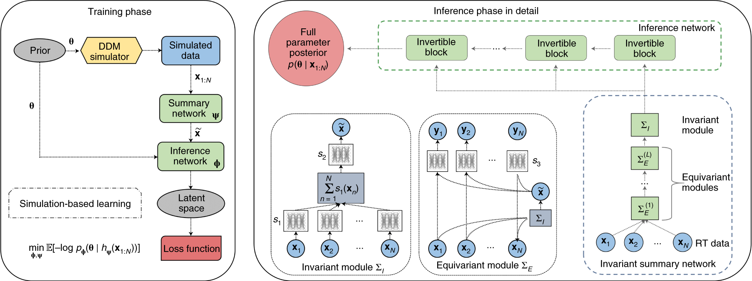
Other experiments
Really? Is this not some weird artefact of the data?
Notes:
Bayesian posterior estimation with artificial nueral networks

Slide 40
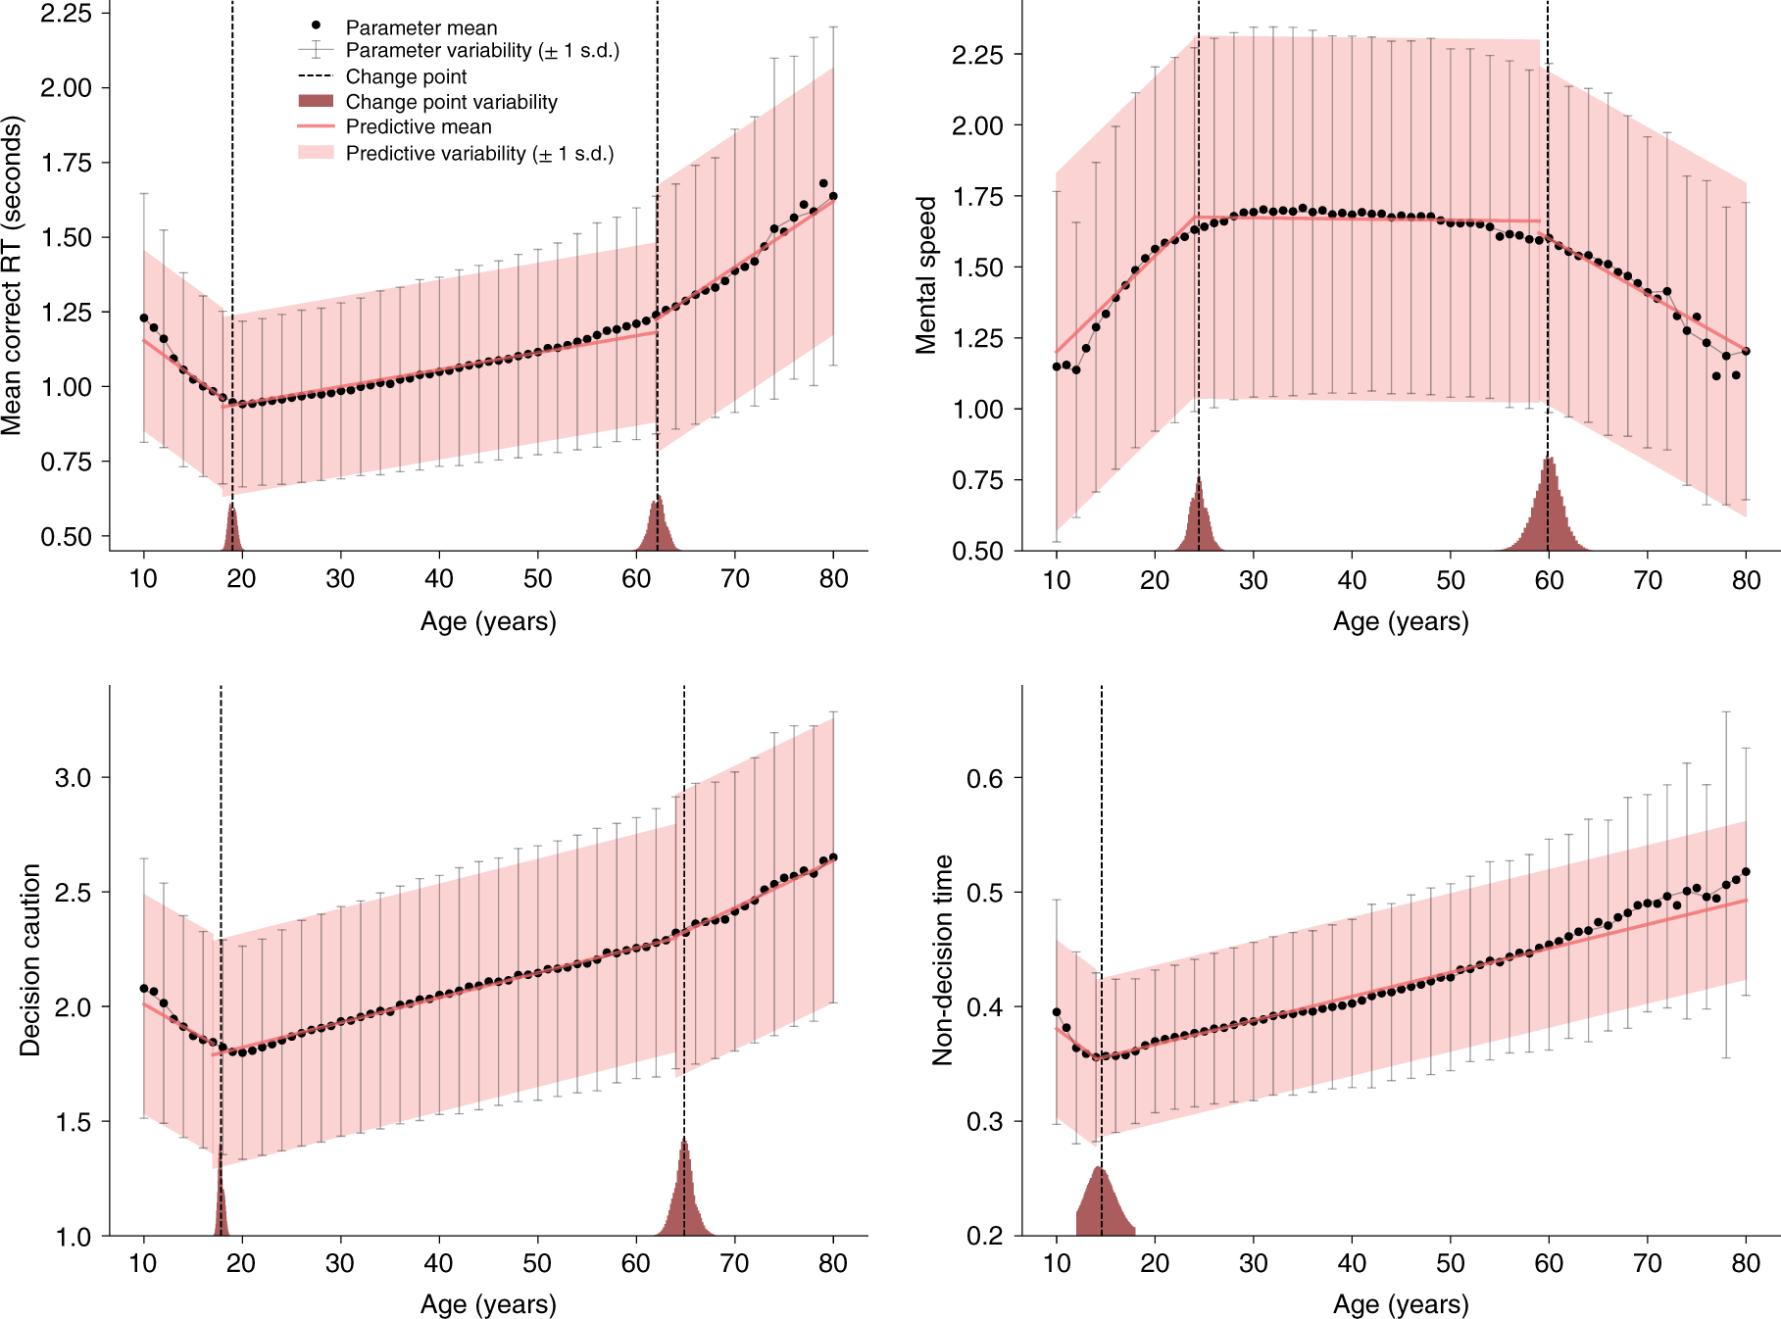
Other experiments
Really? Is this not some weird artefact of the data?
Notes:
1.2 MILLION participants

Slide 41
Overview
A brief recap
Classical experiments
Threshold manipulations
Starting point manipulations
Rate manipulations
Practical issues when fitting
Likelihoods
Notation
Identifiability

Slide 42
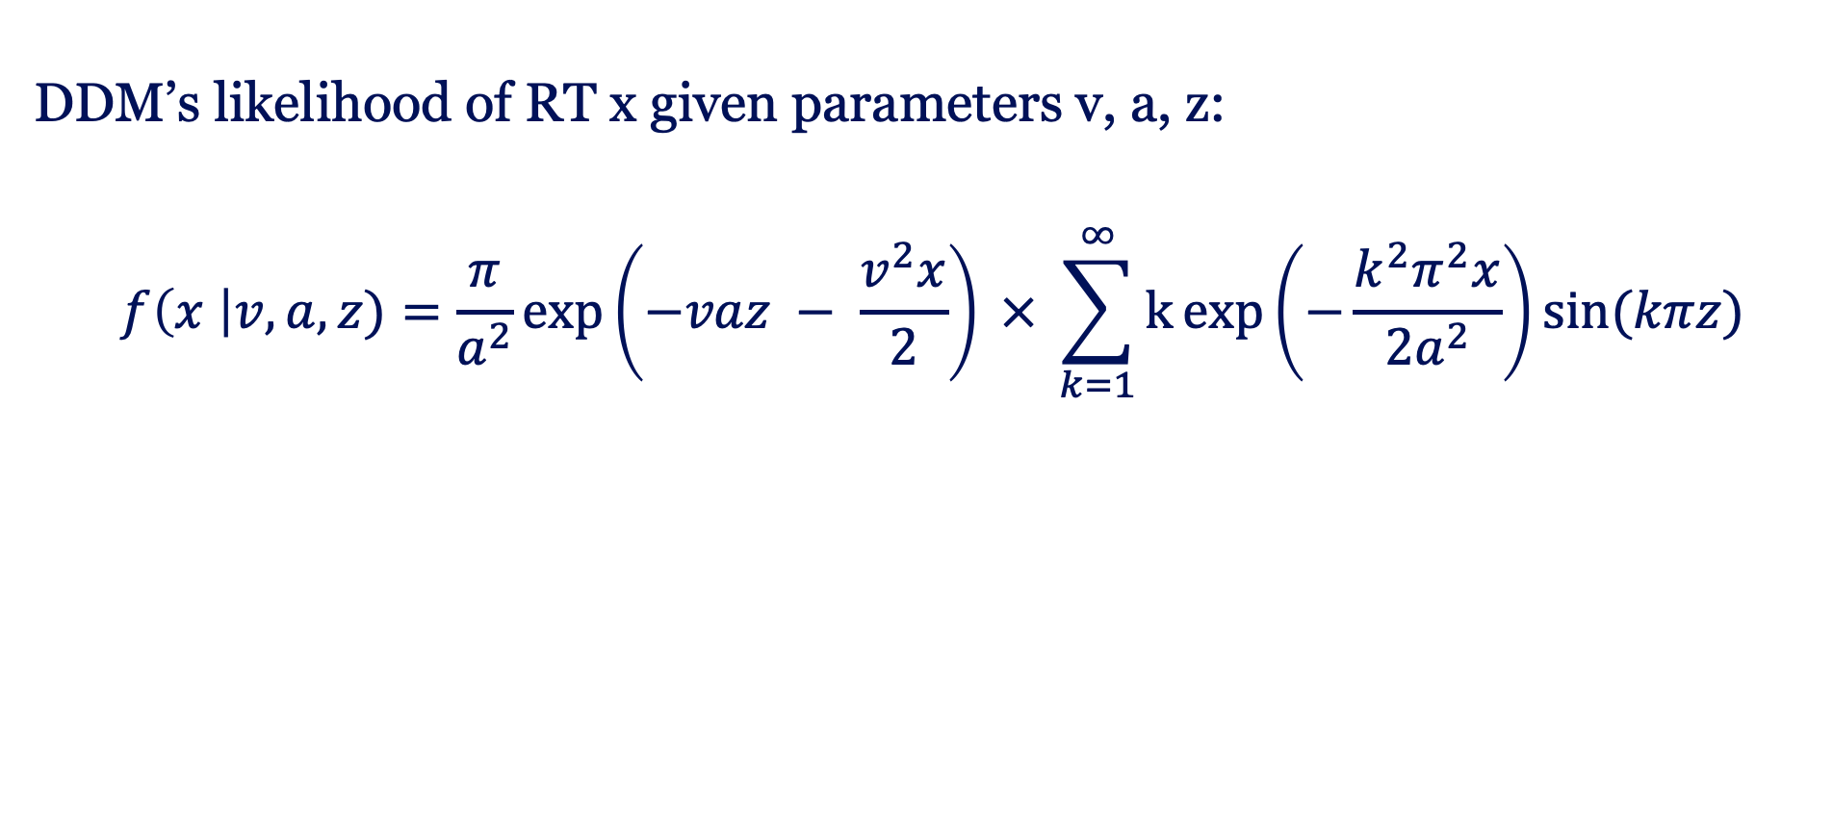
Likelihood
DDM’s likelihood of RT x given parameters v, a, z:
$$f\left(x \right|v, a, z)=\frac{π}{a^{2}}\exp\left(−vaz − \frac{v^{2}x}{2}\right) × \sum_{k=1}^{∞}{k\exp\left(−\frac{k^{2}π^{2}x}{2a^{2}}\right)sin⁡(kπz)}$$

Slide 43
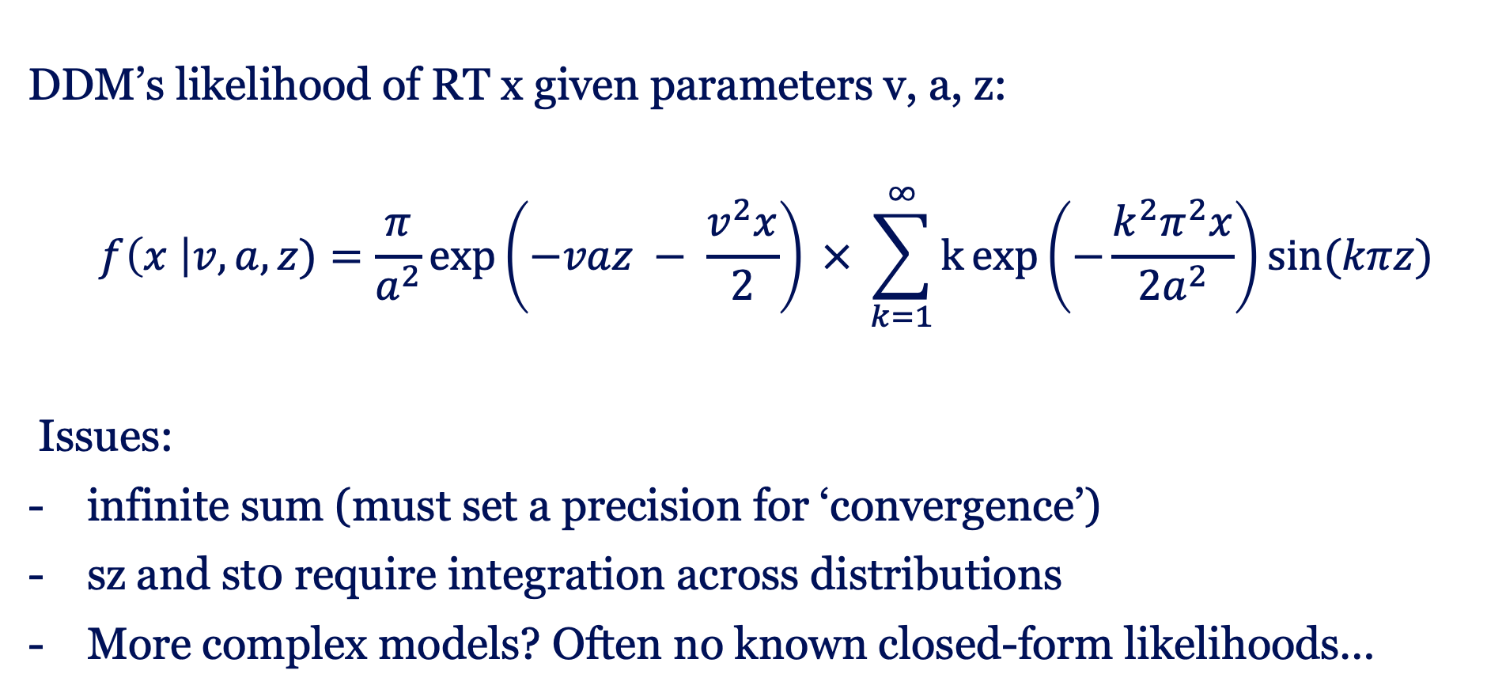
Likelihood
DDM’s likelihood of RT x given parameters v, a, z:
$$f\left(x \right|v, a, z)=\frac{π}{a^{2}}\exp\left(−vaz − \frac{v^{2}x}{2}\right) × \sum_{k=1}^{∞}{k\exp\left(−\frac{k^{2}π^{2}x}{2a^{2}}\right)sin⁡(kπz)}$$
Issues:
infinite sum (must set a precision for ‘convergence’)
sz and st0 require integration across distributions
More complex models? Often no known closed-form likelihoods…

Slide 44
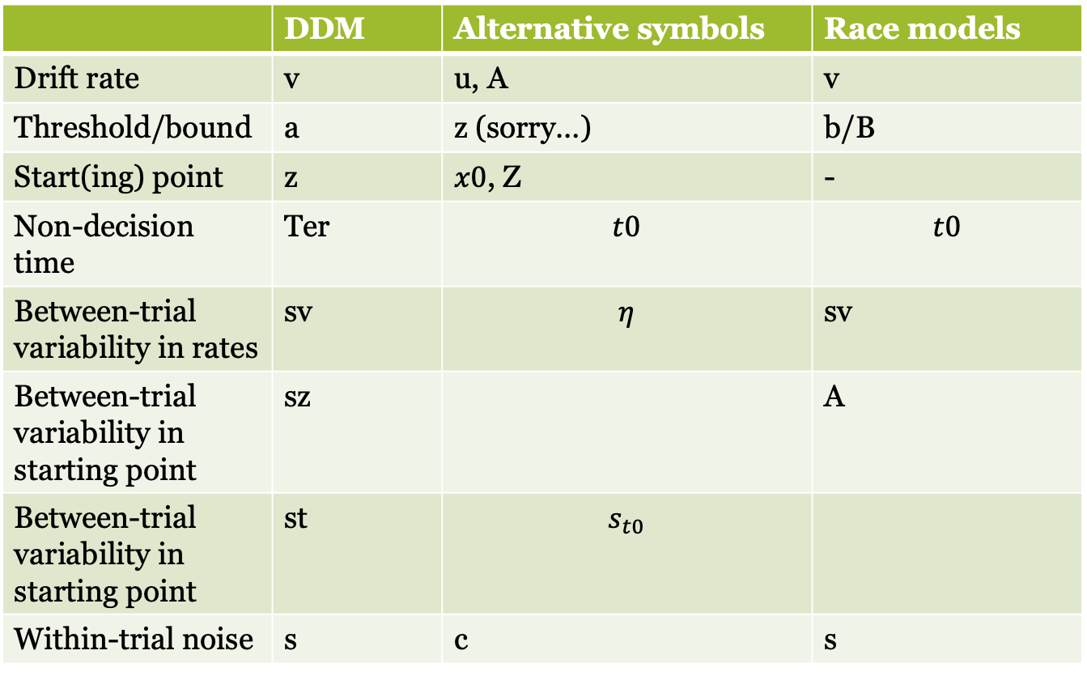
Notation
Parameters go by different symbols…
 | DDM | Alternative symbols | Race models
Drift rate | v | u, A | v
Threshold/bound | a | z (sorry…) | b/B
Start(ing) point | z | $x0$, Z | -
Non-decision time | Ter | $$t0$$ | $$t0$$
Between-trial variability in rates | sv | $$η$$ | sv
Between-trial variability in starting point | sz |  | A
Between-trial variability in starting point | st | $$s_{t0}$$
Within-trial noise | s | c | s

Slide 45
Notation
Parameters go by different symbols…
And slightly different parametrisations of the bounds:
lower bound = 0, upper bound = a
Then unbiased starting point z = a/2
Lower bound = -a, upper bound = a
Then unbiased starting point z = 0
I.e., be careful and specific about which parameter you are referring to with which symbol

Slide 46
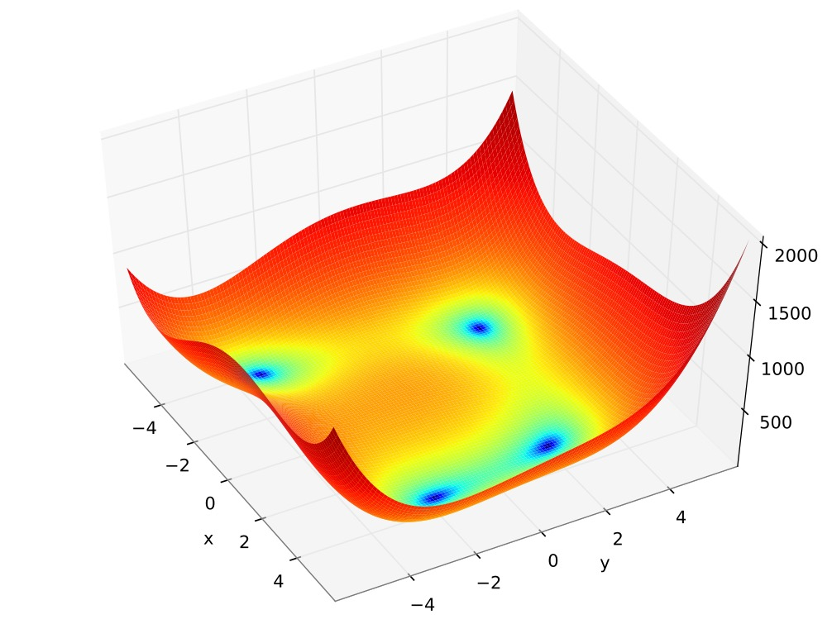
Identifiability
Evidence accumulation models are unidentified
Multiple sets of parameters
can fit equally well

Slide 47
Identifiability
Try it yourself: https://colab.research.google.com/github/mwshinn/PyDDM/blob/master/doc/notebooks/interactive_demo.ipynb#scrollTo=LyBBVtpquqv2

Slide 48
Identifiability
To make these models identifiable, one parameter should always be set to a constant
Typically, we set the within-trial noise to 1 (0r 0.1)
(Donkin et al., 2009; Van Maanen & Miletić, 2021)

Slide 49
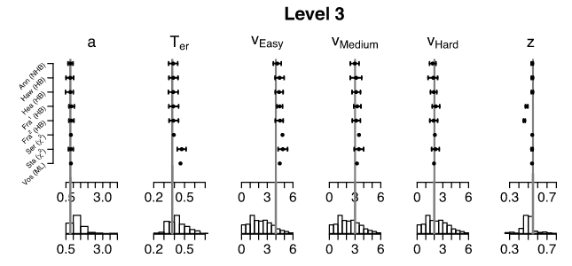
Identifiability
However, even with a scaling parameter fixed, some parameters do not recover well
Boehm et al. (2018)

Slide 50
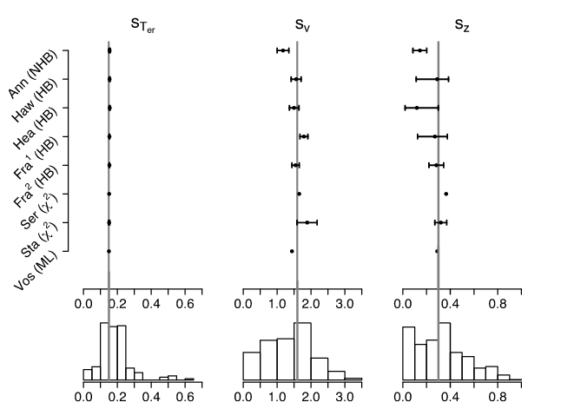
Identifiability
However, even with a scaling parameter fixed, some parameters do not recover well
Boehm et al. (2018)

Slide 51
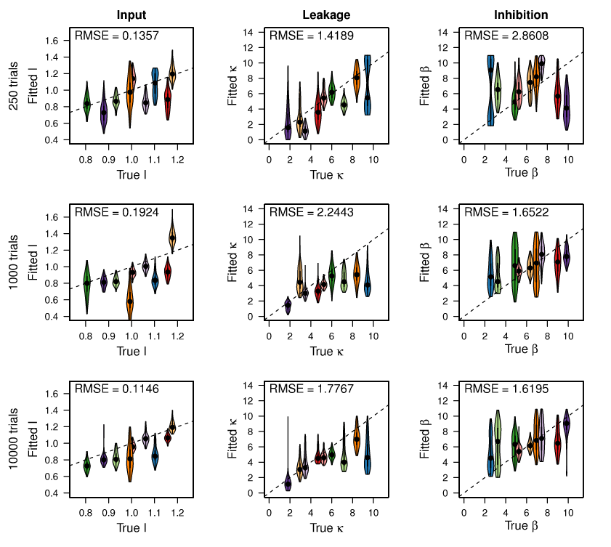
Identifiability
However, even with a scaling parameter fixed, some parameters do not recover well
Which becomes a bigger issue with more complex models
Miletic et al. (2017)

Slide 52
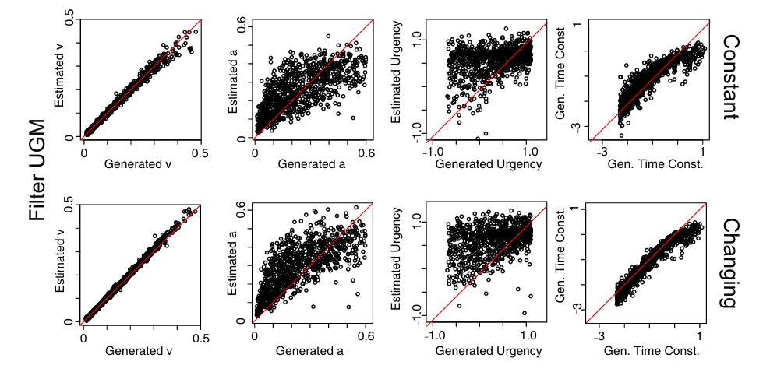
Identifiability
However, even with a scaling parameter fixed, some parameters do not recover well
Which becomes a bigger issue with more complex models
Evans et al. (2019)

Slide 53
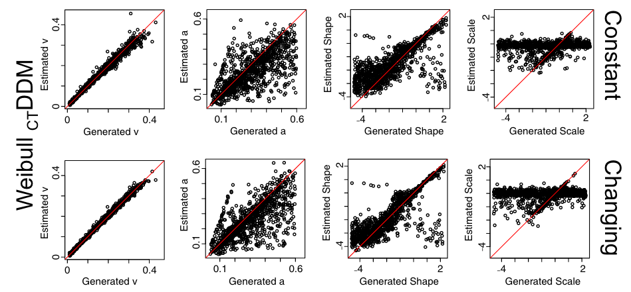
Identifiability
However, even with a scaling parameter fixed, some parameters do not recover well
Which becomes a bigger issue with more complex models
Evans et al. (2019)

Slide 54
Identifiability
However, even with a scaling parameter fixed, some parameters do not recover well
Which becomes a bigger issue with more complex models
There are limits in the amount of information available in response time distributions

Slide 55
Title closure

